Slide 1
Major Assignment 3
Analysis and visualization

Slide 2
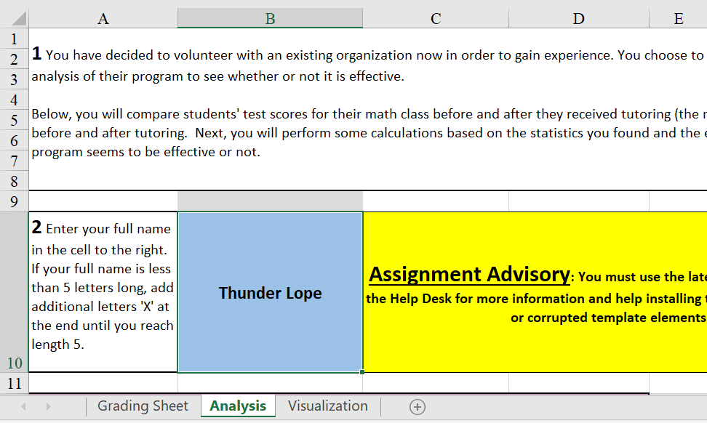
Analysis – Part 2
Enter your full name in the blue cell in Part 2 to generate the scores in the columns below.

Slide 3
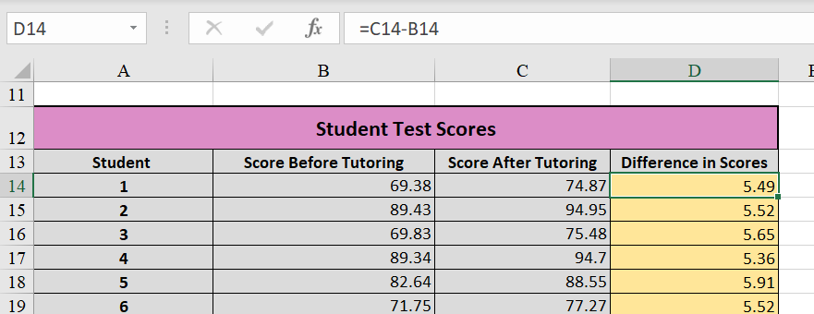
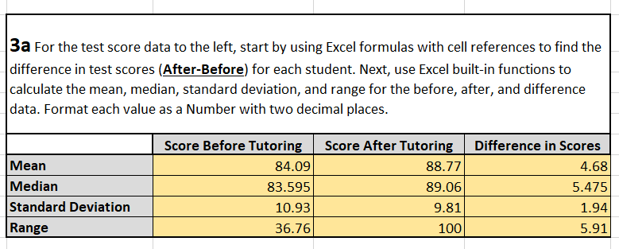
Analysis – Part 3a
Start by finding the Difference in Scores
Difference in Scores = After - Before
Then find the Mean, Median, Standard Deviation, and Range for the Scores Before Tutoring, Scores After Tutoring, and the Difference in Scores
Mean Function
=AVERAGE()
Median Function
=MEDIAN()
Standard Deviation Function
=STDEV()
Range Formula with Functions
=MAX() – MIN()
See the next slide for resources on how to use the functions.

Slide 4
Analysis – Part 3a cont.
=AVERAGE()
https://support.microsoft.com/en-us/office/average-function-047bac88-d466-426c-a32b-8f33eb960cf6
=MEDIAN()
https://support.microsoft.com/en-us/office/median-function-d0916313-4753-414c-8537-ce85bdd967d2
=STDEV()
https://support.microsoft.com/en-au/office/stdev-function-51fecaaa-231e-4bbb-9230-33650a72c9b0
=MAX() – MIN()
MAX()
https://support.microsoft.com/en-gb/office/max-function-e0012414-9ac8-4b34-9a47-73e662c08098
MIN()
https://support.microsoft.com/en-us/office/min-function-61635d12-920f-4ce2-a70f-96f202dcc152

Slide 5
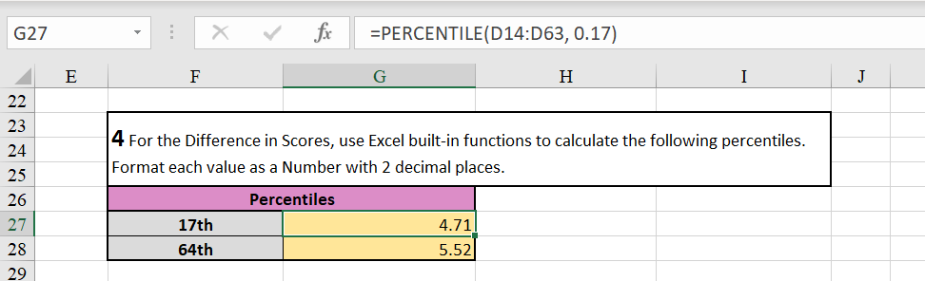
Analysis – Part 4
Use the =PERCENTILE() function to find the appropriate percentiles.
=PERCENTILE(Difference in Scores, percentile as a decimal)
https://support.microsoft.com/en-gb/office/percentile-function-91b43a53-543c-4708-93de-d626debdddca#:~:text=Returns%20the%20k%2Dth%20percentile,score%20above%20the%2090th%20percentile.

Slide 6
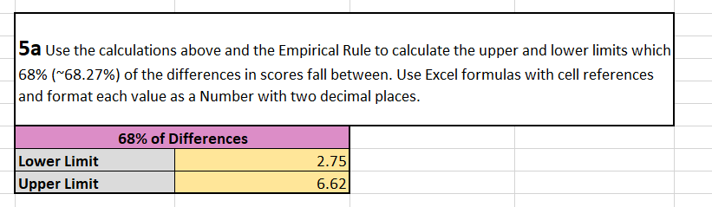
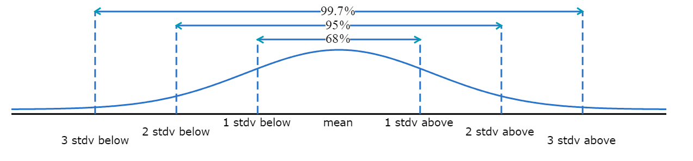
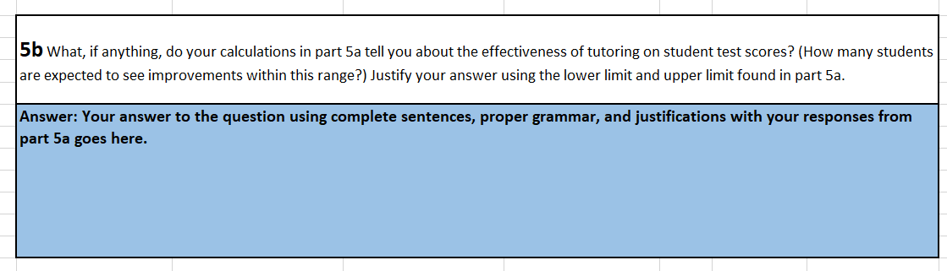
Analysis – Part 5
Use the Empirical Rule and calculations from part 3a to find the Lower Limit and Upper Limit for which the given percentage of Difference in Scores fall between.
The Empirical Rule
Approximately 68% of the area under the curve lies within one standard deviation of the mean.
Approximately 95% of the area under the curve lies within two standard deviations of the mean.
Approximately 99.7% of the area under the curve lies within three standard deviations of the mean.
Then answer the question in part 5b based on your response in part 5a. Follow any special directions provided by your instructor.
Empirical Rule

Slide 7
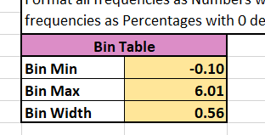
Visualization – Part 7
Start by finding the Bin Min, Bin Max, and Bin Width for the Difference in Scores. Include a buffer of 0.1 in the Bin Min and Bin Max for technical reasons.
Bin Min =MIN(Differences) – 0.1
Bin Max =MAX(Differences) + 0.1
Bin Width =(Bin Max – Bin Min)/Number of Bins

Slide 8
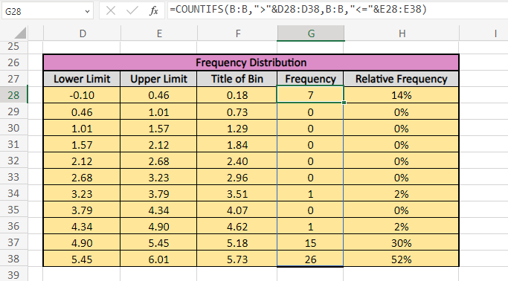
Visualization – Part 7 cont.
Lower Limits
The first Lower Limit is the Bin Min
The remaining Lower Limits are the previous Upper Limit
Upper Limits = Lower Limit + Bin Width
Title of Bin = (Upper Limit + Lower Limit)/2
Frequency
=COUNTIFS(Difference in Scores, “>”& Lower Limits, Difference in Scores, “<=“& Upper Limits)
https://support.microsoft.com/en-gb/office/countifs-function-dda3dc6e-f74e-4aee-88bc-aa8c2a866842
Relative Frequency =Frequency/COUNT(Differences)
https://support.microsoft.com/en-us/office/count-function-a59cd7fc-b623-4d93-87a4-d23bf411294c#:~:text=Use%20the%20COUNT%20function%20to,numbers%2C%20the%20result%20is%205.

Slide 9
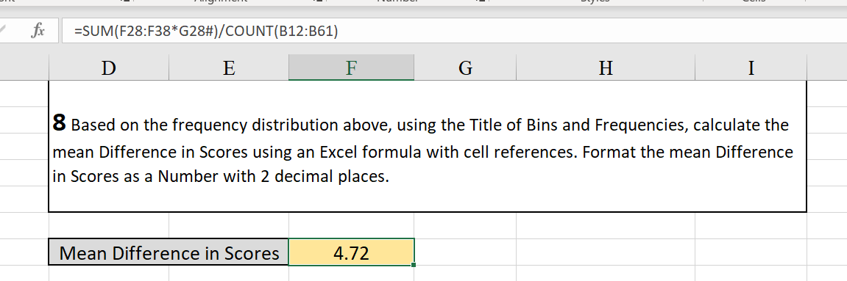
Visualization – Part 8
Find the Mean Difference in Scores based on the Titles of the Bins and Frequencies.
=SUM(Title of Bins * Frequencies)/Total Number of Scores

Slide 10
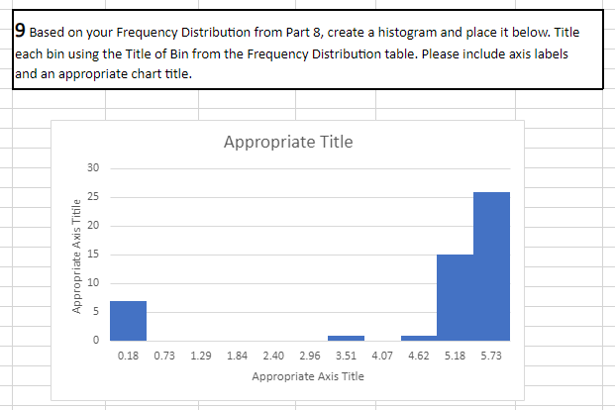
Visualization – Part 8
Create a histogram modeling the frequencies with an appropriate title and axis labels. Title each bin using the Title of Bin from part 7.

